Slide 1
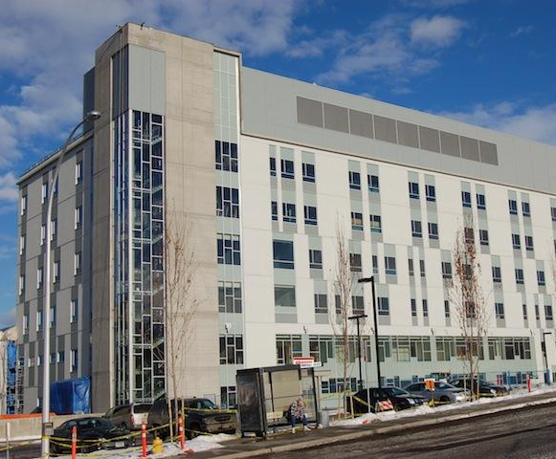
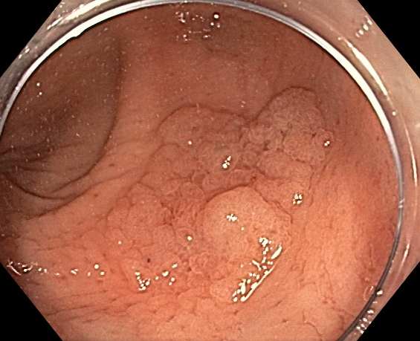
Improving the Management and Outcomes of Complex Non-Pedunculated Colorectal Polyps at a Regional Hospital in British Columbia
Lina Cadili, Michael Horkoff, Scott Ainslie, Brian Chai, Jeffrey S. Demetrick, Karl Langer, Kevin Wiseman, Hamish Hwang
British Columbia Surgical Society Annual Spring Meeting
May 5, 2023

Slide 2
Disclosure
We have no conflicts of interests or financial disclosures.

Slide 3
Background
Colon cancer represents 11% of all cancer-related deaths in Canada
Deaths from colorectal cancer reduced by disrupting the adenoma-carcinoma sequence by detecting and removing polyps
Effectiveness of screening dependent on the ability to carry out polypectomy
Some polyps pose significant technical challenges
Size
Location
Morphology.

Slide 4
Objective
To review the management and outcomes of complex non-pedunculated colorectal polyps before and after the implementation of a protocol for these polyps at VJH.

Slide 5
Methods
Standardized protocol
Based on Cancer Care Ontario Regional-Level Guidance on the Management of Complex Polyps
Complex polyp defined as sessile polyps >2cm
Initiated at VJH October 2021
Multidisciplinary review for every complex polyp
Standardized documentation and management guidelines
Six general surgeons and one gastroenterologist performed all colonoscopies and EMR polypectomies at VJH

Slide 6
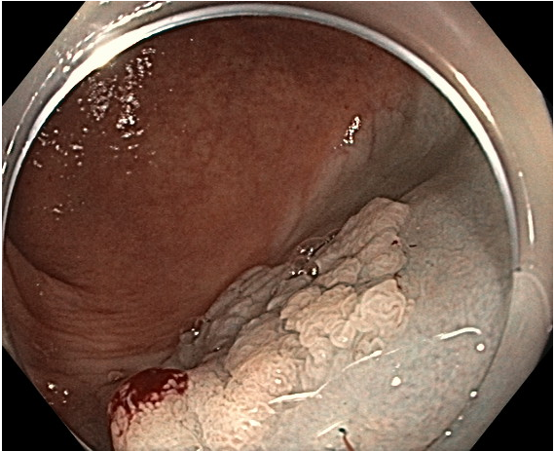
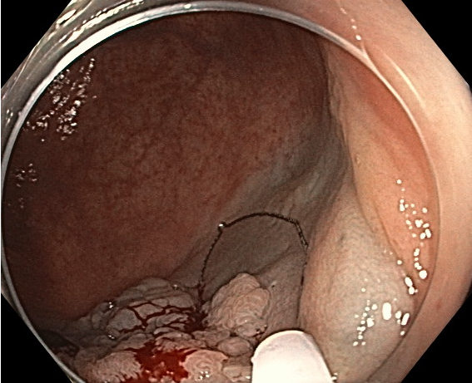
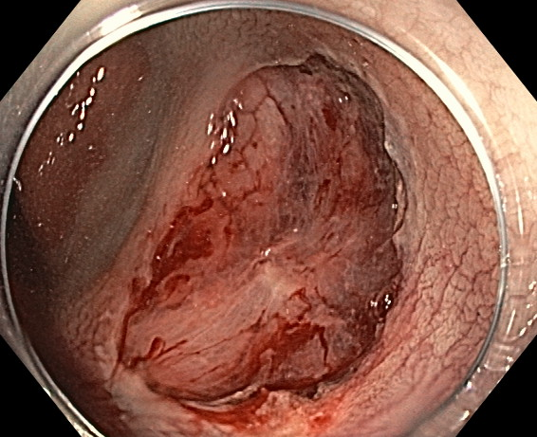
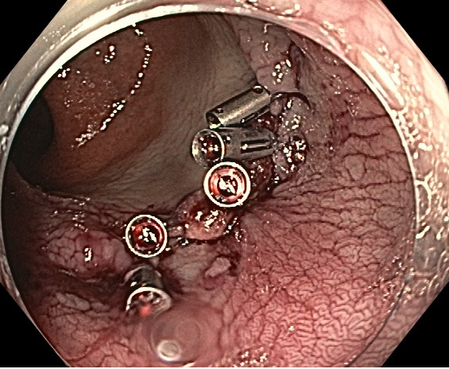

Slide 7
Methods
Pre-protocol – October 2020 – September 2021
Post-protocol – October 2021 – September 2022
Complex polyp = any sessile polyp $≥$2cm
Complex polyp = any sessile polyp ≥2cm
Excluded: Recurrent and pedunculated polyps
Chart Reviews
Documentation Management Outcomes

Slide 8
Results

Slide 9
Documentation
 | Pre-Protocol (n = 69) | Post-Protocol (n = 72) | P-Value
Primary vs. Recurrent | 100% (69) | 100% (72) | 1.000
Polyp Location | 100% (69) | 100% (72) | 1.000
Photograph Taken | 88.4% (61) | 91.7% (66) | 0.517
Polyp Size | 76.8% (53) | 87.5% (63) | 0.097
Biopsy Taken | 33.3% (23) | 45.7% (32) | 0.176
Tattoo Applied | 52.2% (36) | 41.7% (30) | 0.211
Suspicious Appearance | 21.7% (15) | 47.2% (34) | 0.001
Circumference | 14.5% (10) | 34.7% (25) | 0.005
Morphology | 82.6% (57) | 80.6% (58) | 0.753
Management Plan | 87.0% (60) | 97.2% (70) | 0.023

Slide 10
Management
 | Pre-Protocol (n = 69) | Post-Protocol (n = 72) | P-Value
Multidisciplinary Conference Review | 1% (1) | 61% (45) | <0.005
EMR at Index Colonoscopy | 84% (48/57) | 39% (22/55) | <0.005
Dedicated EMR in 60min slot | 19% (11/57) | 58% (33/55) | <0.005
Specific consent for EMR | 22% (12/57) | 57% (32/55) | <0.005
Surgery | 14% (10) | 15% (11) | 0.896
Referred to Regional Expert | 3% (2) | 6% (4) | 0.435
Observation | 0 | 3% (2) | 0.163

Slide 11
Management Polyps >3cm
 | Pre-Protocol (n = 23) | Post-Protocol (n = 36) | P-Value
Multidisciplinary Conference Review | 4% (1) | 67% (24) | <0.005
EMR at Index Colonoscopy | 72% (13/18) | 23% (6/28) | 0.001
Dedicated EMR in 60min slot | 33% (6/18) | 75% (21/28) | 0.005
Specific Consent for EMR | 39% (7/18) | 75% (21/28) | 0.014
Surgery | 26% (6/23) | 16% (6/36) | 0.381
Referred to Regional Expert | 9% (2/23) | 3% (1/36) | 0.313
Observation | 0 | 3% (1/36) | -
Notes:
worth pointing out surgery showed a trend downwards (good) Also should clarify EMR at index colonoscopy vs EMR at dedicated 1 hour slot. The 3 observation patients were I believe not candidates for surgery or EMR after MDC discussion.

Slide 12
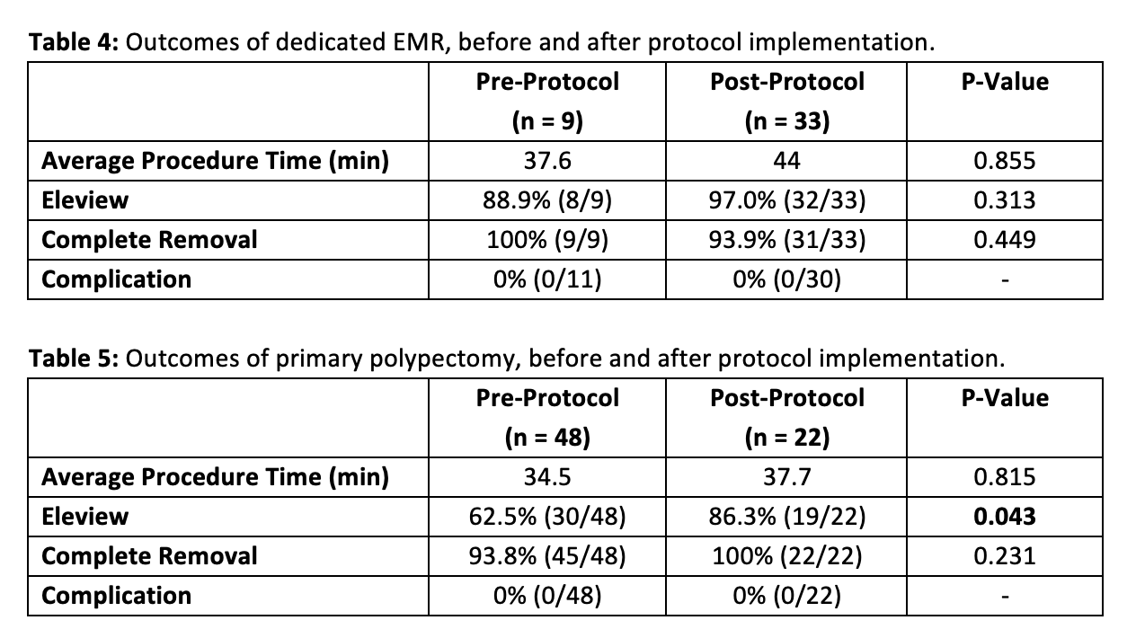
Notes:
At our center, piecemeal injection-assisted EMR (with Eleview) is the most commonly used technique. We found no complications among our study cohort; thus, this technique is safe at our community hospital.

Slide 13
Outcomes: Polyp recurrences
 | Pre-Protocol (n = 36) | Post-Protocol (n = 33) | P-Value
Total Polyp Recurrence | 44.4% (16/36) | 30.3% (10/33) | 0.226
Polyp Recurrence Excluding Small Completely Excised Polyps | 33.3% (12/36) | 3.0% (1/33) | 0.001

Slide 14
Discussion/Conclusion
After protocol introduced
Improvement in documentation
Increased patients reviewed at multidisciplinary conference
Increased complex polypectomies performed at dedicated colonoscopy with specific consent
Decreased trend in patients with polyps over 3cm needing surgery
Decreased recurrences
No complications

Slide 15
Discussion/Conclusion
Limitations
observational, retrospective, small sample size, incomplete recurrence data
Future directions
All endoscopists given their individual results to reflect on
An audit to ensure that documentation and management continue to improve
Follow up project to include polyp pit pattern description (NICE and JNET) into reporting and management.
Notes:
Technically the analysis was retrospective but the patients were accrued prospectively after the implementation of the protocol.

Slide 16
Key Take-Aways
A standardized protocol for polyp documentation and management improves patient outcomes
Advanced endoscopic techniques allow endoscopists to push the limits for endoscopic resection
EMR performed mostly by General Surgeons is safe in a community hospital (0% complication rate)

