Slide 1
VJHPS AGM
June 24, 2021
8:00 AM – 8:30 AM

Slide 2
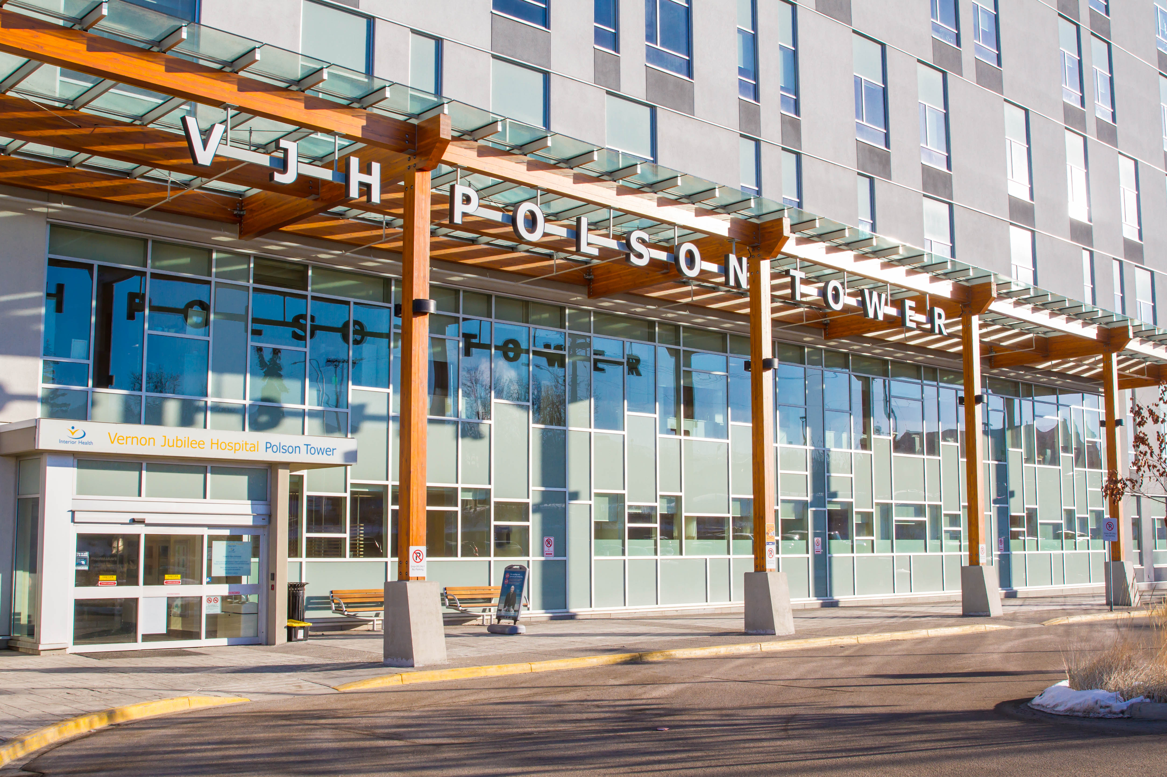
What is facility engagement?

Slide 3
What is facility engagement?
A funding initiative through Doctors of BC and the Ministry of Health
Annual budget is determined based on the size of the facility ($400,000 per year for us)
To improve physician engagement
This Photo by Unknown Author is licensed under CC BY-SA-NC
This Photo by Unknown Author is licensed under CC BY-SA-NC

Slide 4
MOU Partners

Slide 5
Who created the Society?
Our MSA created the Vernon Jubilee Hospital Physician Society, enabling us to receive and manage funds, $400,000 per annum, from the Doctors of BC Specialist Services Committee to carry out Facility Engagement activities at our hospital.

Slide 6
Our Vision
to be “…an agent of positive change and an effective partner within the B.C. Health Care System”

Slide 7
What is our mission?
To be heard
To bring your ideas to “real life”
To improve your work environment
To provide better patient care
To improve relationships and
collaboration within our facility and regionally

Slide 8
Working on your behalf
VJH Physician Society Working Group
VJHPS/MSA Executive
President | Dr. Kira McClellan
Vice President | Dr. Yann Brierley
Secretary Treasurer | Dr. Jason Doyle
Board Member at Large | Dr. Marius Aucamp
Board Member at Large MSA | Dr. Richard Harper
VJH Departments
Anesthesiology | Dr. Tom Cull
Diagnostic Imaging | Dr. Adam Weathermon
Emergency Medicine | Dr. Leanne Hewitson
Family Medicine | Drs. Cunningham, Harper, Rourke & McClellan
Hospitalist Medicine | Dr. Marius Aucamp
Internal Medicine | Dr. David Spicer
Laboratory Medicine | Drs. Brierley & Doyle
Psychiatry | Dr. Kevin Stevenson
Surgery | Drs. Kevin Wiseman & Michael Horkoff
Women’s & Children’s Medicine | Drs. Lia Harris & Noha Fossen
Other
SNO Division of Family Practice | Dr. Mark Ansdell
Doctors of BC, SSC Facility Engagement Partner | Cheryl Drewitz-Chesney
VJHPS Project Manager | Anna Flasch
VJHPS Administrative | Maja Keast

Slide 9
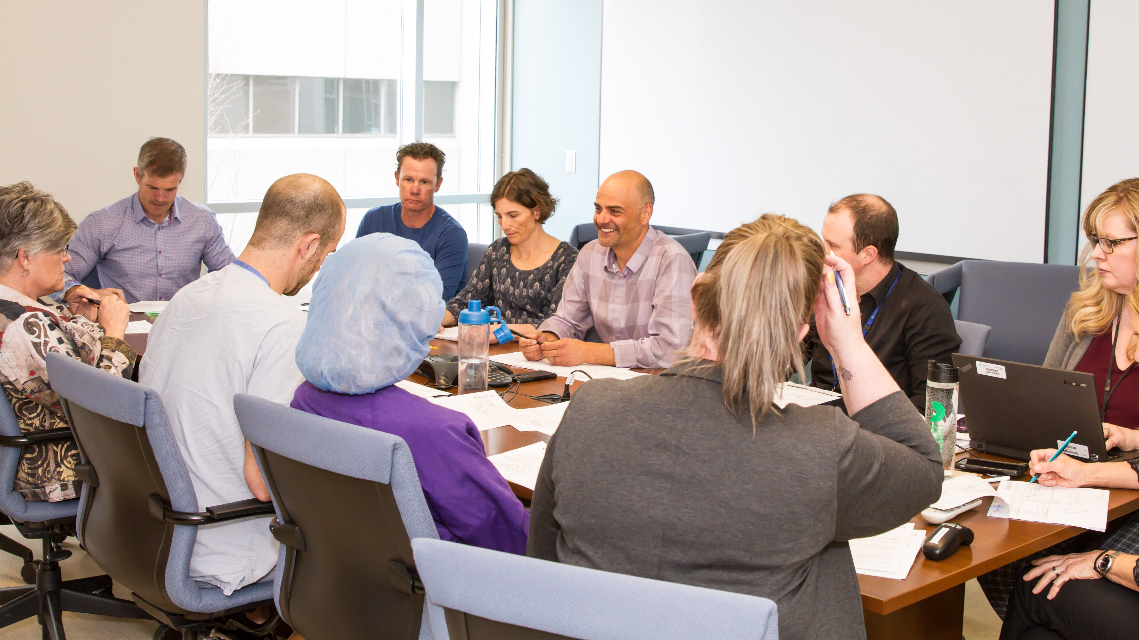
What is the funding for?

Slide 10
How can this funding be used?
Bringing projects and ideas to real life
Compensating you for your
non-clinical involvement at VJH
Sessional reimbursement
Expense reimbursement

Slide 11
Top priorities for 2020/2021
Physician Wellness & Morale
Recruitment and Retention
Obtaining a relevant voice locally and regionally
Advisory committees with IH

Slide 12
YEAR AT A GLANCE
161+ Medical Staff involved in Facility Engagement
46 Facility Engagement Activities Completed since 2016
28 Facility Engagement Activities during 2020-2021

Slide 13
2020/2021 Activities
Allied Health Education
Centralized Booking for General Surgery (Hernia/Gallbladder)
Communication Plan
COVID Activities
Departmental/Interdepartmental Enrichment Meetings
Inter-Society Facility Engagement Sessional Reimbursement
Internal Medicine Perioperative Optimization Clinic
M&M Catering
MOH Retroactive Payments for GP Physicians VJHPS
Physician Common Area Refurbishment
Physician Engagement Co-sponsorship Support
Physician Recruitment

Slide 14
2020/2021 Activities Continued
Physician Wellness Co-sponsored with SNO
Reducing Redundant Lap Testing
Resuscitation/Simulations (SIMS)
Strategic Planning – Departments of Family & Hospitalist Medicine
Surgical Checklist Simulation & Redesign
Uncharted Missed Documents from VJH to Community MDs Review
Uncompensated Committee Work
VJHPS Daycare vs. Inpatient breast surgery
VJHPS Visioning
Governance
VJHPS & MSA Streamlining Activity
VJHPS Working Group

Slide 15
YEAR AT A GLANCE
Vernon Alliance Initiative = 42 partner activities ongoing
bringing all of your funding sources to one table, meeting monthly to support you and your projects
PQI (Physician Quality Improvement)
IH QI (Quality Improvement)
HSR (Physician Engagement in Health System Redesign)
PSP (Practice Support Program)
SNO Divisions of Family Practice
VJH Foundation
VJH Physician Society (Facility Engagement) – includes the 28 active activities
VJH Administration (Senior Medical Director, Chief of Staff, & VJH Administrator)

Slide 16
YEAR AT A GLANCE
Success Achieved!
Parking Attendant reinstatement = making your morning more enjoyable!

Slide 17
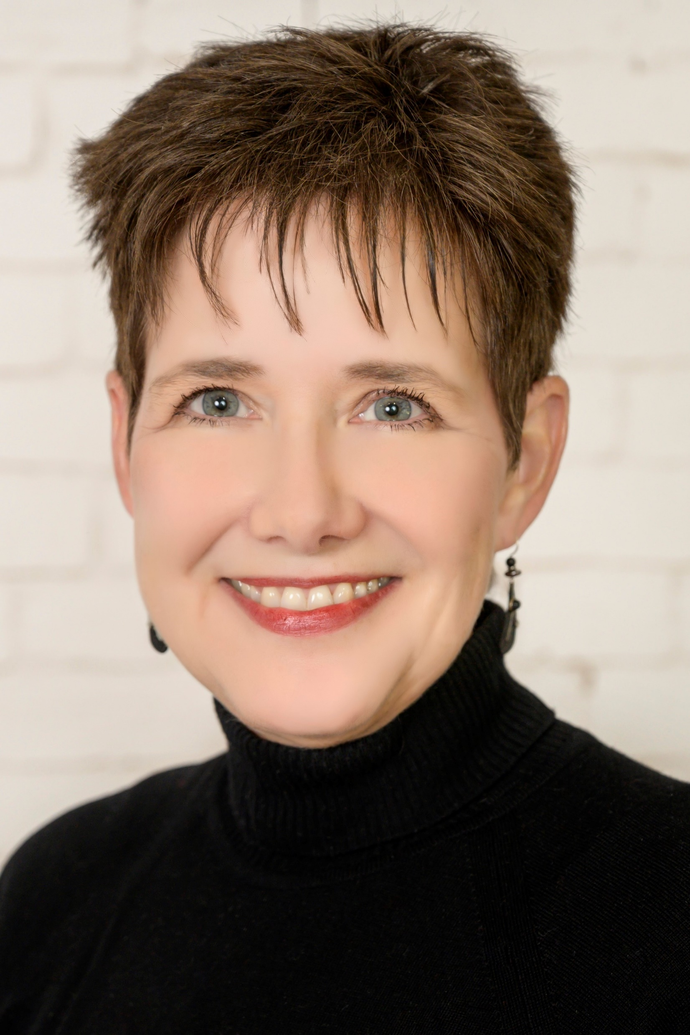
www.vernonphysiciansociety.ca
Congratulations to Sharon Hughes-Geekie our new Program Director.

Slide 18
www.vernonphysiciansociety.ca

