Slide 1
MSA AGM
June 24, 2021
7:00 AM – 8:00 AM

Slide 2
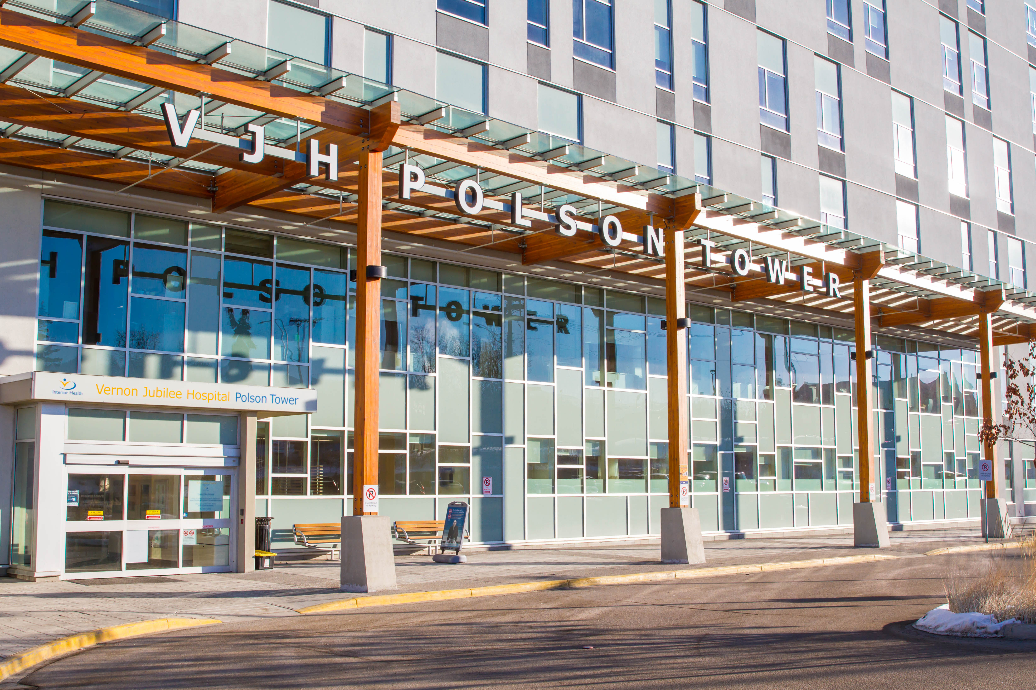

VJHPS/MSA past and future

Slide 3

Towards Simplicity
Select the best and simplest governance structure to support the medical staff
Refine Roles and Responsibilities – VJHPS/MSA Board and it’s administrative support
Rolling out the new model!

Slide 4

The Why?
Streamlining the medical staff body under one governance
Clarity regarding the VJHPS/MSA roles and responsibilities
Ease for Interior Health Authority (IHA) to engage VJHPS & MSA

Slide 5
Our New Model

Slide 6

Scorecard
Present the new organizational chart to the MSA for a vote
Transition Executive from two Boards into one
Revise the VJHPS Bylaws
Operate as one bridged entity but maintain two distinct organizations
Define roles and responsibilities of the Board & Administration
Maintain and manage separate finances
Vote on the revised bylaws

Slide 7

The Future
A Passionate and Engaged MSA
Upcoming Social Events
          MSA FAMILY BBQ - Sept 26th
            2021Paddlewheel Park

Slide 8

Questions?

